Slide 1
MongoDB

Slide 2

MongoDB
Open-source document database
The most popular NoSQL database
Cross-platform
Document oriented database
Popular among app developers because
Ease of use, simplified model, elastic scale, and comprehensive tooling.
Notes:
https://www.tutorialspoint.com/mongodb/

Slide 3
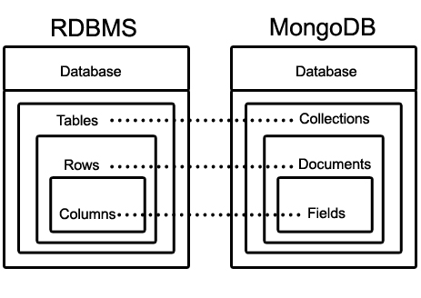
RDBMS vs MongoDB
RDBMS | MongoDB
Database | Database
Table | Collection
Tuple/Row/Record | Document
Column | Field
Table Join | Embedded Documents
Primary key | Primary key (Default key_id provided by mongodb itself)

Slide 4
Collection
A single MongoDB server typically has multiple databases.
A collection is a group of MongoDB documents.
Equivalent of an RDBMS table
Do not enforce a schema.
Schemaless
Documents within a collection can have different fields.
Typically all documents in a collection are of similar or of related purpose.

Slide 5
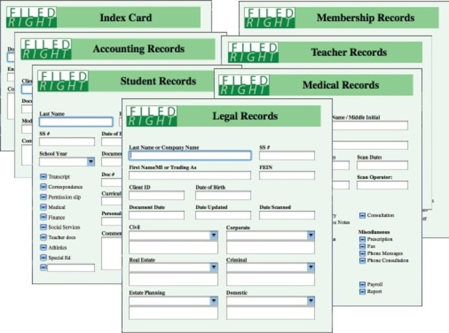
Document
A set of key-value pairs.
Dynamic schema
Documents in the same collection do not need to have the same set of fields or structure.
Common fields in a collection’s documents may hold different types of data.

Slide 6
JSON
JSON is a language-independent data format.
It was derived from JavaScript, but many modern programming languages include code to generate and parse JSON-format data.
Data objects consisting of attribute–value pairs(key-value pairs).

Slide 7
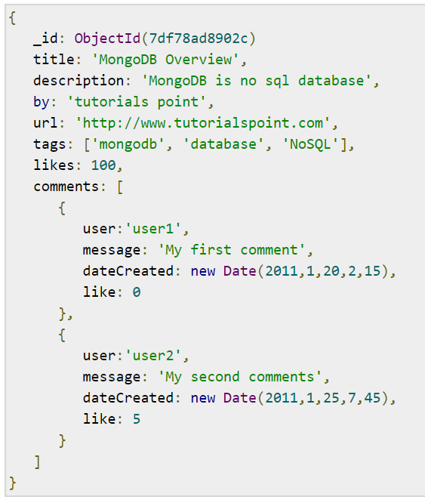
Sample Document
Unique id
Document structure of a blog site
Key-value pairs
key
Value

Slide 8
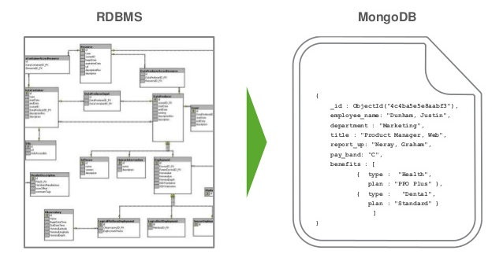
Aggregation
Aggregate the tables together

Slide 9
 | Relational DB | MongoDB
Data Structure | Tables & Relationships | Document (JSON) & Collection (of documents)
Data Generation | CREATE clause INSERT INTO clause | Insert() method
Data Update | UPDATE clause | Update() method Upsert() method
Data Deletion | DELETE clause | Delete() method
Query | SELECT clause FROM clause | Find() method
Result Filtering | WHERE clause | Query and Projection parameters in Find()
Result Limiting, Sorting, Counting | ORDER BY COUNT() function | Limit() method Skip() method Sort() method Count() method
Grouping, Aggregation | GROUPY BY clause HAVING clause Aggregate functions in SELECT | Aggregate() method
Piping | Subquery | Aggregate() method

Slide 10
Advantages of MongoDB over RDBMS
Schema-less
Structure of a single object is clear
No complex joins
Deep query-ability
Ease of scale out (horizontally)
Conversion/mapping of application objects to database objects not needed
Uses internal memory for storing the working set, enabling faster access of data.
Notes:
Schema less − MongoDB is a document database in which one collection holds different documents. Number of fields, content and size of the document can differ from one document to another.
Structure of a single object is clear.
No complex joins.
Deep query-ability. MongoDB supports dynamic queries on documents using a document-based query language that's nearly as powerful as SQL.
Tuning.
Ease of scale-out − MongoDB is easy to scale.
Conversion/mapping of application objects to database objects not needed.
Uses internal memory for storing the (windowed) working set, enabling faster access of data.

Slide 11
Why Use MongoDB?
Document oriented storage
Data is stored in the form of JSON style documents
Index on any attribute
Replication and high availability
Auto-sharding
Rich queries
Fast in-place updates
Professional supported by MongoDB

Slide 12
Where to Use MongoDB
Big data
Content management and delivery
Blogging platforms
Analytics platforms
E-commerce platforms
Applications
SEGA (Japanese multinational video game developer and publisher) uses cloud hosted MongoDB for handling 11 million in-game accounts
Aer Lingus (the flag carrier airline of Irelan) uses MongoDB with Studio 3T to handle ticketing and internal apps
Built on MongoDB, The Weather Channel’s iOS and Android apps deliver weather alerts to 40 million users in real-time

Slide 13
Data Modeling

Slide 14
Considerations while Design
Design your schema according to user requirements
Combine objects into one document if you will use them together. Otherwise separate them (but make sure there should not be need of joins)
Duplicate the data (but limited) because disk space is cheap as compared to compute time
Optimize your schema for most frequent use cases

Slide 15
Example
Suppose a client needs a database design for his blog/website and see the differences between RDBMS and MongoDB schema design. Website has the following requirements.
Every post has the unique title, description and url.
Every post can have one or more tags.
Every post has the name of its publisher and total number of likes.
Every post has comments given by users along with their name, message, data-time and likes.
On each post, there can be zero or more comments.
Notes:
https://www.tutorialspoint.com/mongodb/mongodb_data_modeling.htm

Slide 16
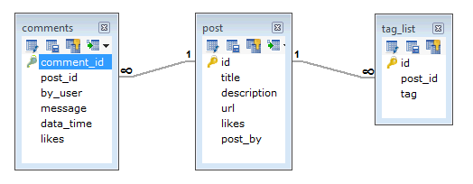
RDBMS Schema

Slide 17
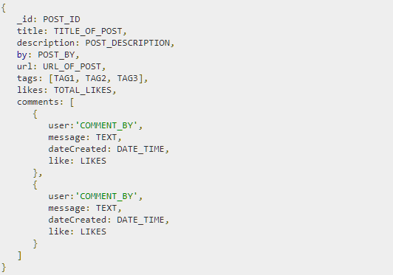
MongoDB Schema

Slide 18
The use Command
In MongoDB, default database is test. If you didn't create any database, then collections will be stored in test database.
Create/switch to a database
Check your currently selected database
Check your database list
use DATABASE_NAME
db
show dbs

Slide 19
The dropDatabase() Method
Delete the selected database
The default database is test. If you have not selected any database, then it will delete default 'test' database.
db.dropDatabase()

Slide 20
Create Collection
Create a collection
db.createCollection(name,options)
Parameter | Type | Description
Name | String | Name of the collection to be created
Options | Document | (Optional) Specify options about memory size and indexing

Slide 21
Options
Field | Type | Description
capped | Boolean | (Optional) If true, enables a capped collection. Capped collection is a fixed size collection that automatically overwrites its oldest entries when it reaches its maximum size. If you specify true, you need to specify size parameter also.
autoIndexId | Boolean | (Optional) If true, automatically create index on _id field. Default value is false. IMPORTANT: Starting in MongoDB 4.0, you cannot set the option autoIndexId to false when creating collections in databases other than the local database.
size | number | (Optional) Specifies a maximum size in bytes for a capped collection. If capped is true, then you need to specify this field also.
max | number | (Optional) Specifies the maximum number of documents allowed in the capped collection.

Slide 22
Create Collection
Create a collection
Create a collection with options
Check the collections in a database
db.createCollection(“mycol”)
db.createCollection("mycollection",{capped:true,autoIndexId:true,size:6142800,max:10000})
show collections

Slide 23
Drop Collection
Drop a collection
db.COLLECTION_NAME.drop()
db.mycollection.drop()

Slide 24
Datatypes
String − This is the most commonly used datatype to store the data. String in MongoDB must be UTF-8 valid.
Integer − This type is used to store a numerical value. Integer can be 32 bit or 64 bit depending upon your server.
Boolean − This type is used to store a boolean (true/ false) value.
Double − This type is used to store floating point values.
Min/ Max keys − This type is used to compare a value against the lowest and highest BSON elements.
Arrays − This type is used to store arrays or list or multiple values into one key.
Timestamp − This can be handy for recording when a document has been modified or added.
Object − This datatype is used for embedded documents.
Null − This type is used to store a Null value.
Symbol − This datatype is used identically to a string; however, it's generally reserved for languages that use a specific symbol type.
Date − This datatype is used to store the current date or time in UNIX time format. You can specify your own date time by creating object of Date and passing day, month, year into it.
Object ID − This datatype is used to store the document’s ID.
Binary data − This datatype is used to store binary data.
Code − This datatype is used to store JavaScript code into the document.
Regular expression − This datatype is used to store regular expression.

Slide 25
Insert document
Insert a document
Create a collection with options
db.COLLECTION_NAME.insert(document)
db.mycol.insert({
title: 'MongoDB Overview',
description: 'MongoDB is a NoSQL database',
by: 'tutorials point',
url: 'http://www.tutorialspoint.com',
tags: ['mongodb', 'database', 'NoSQL'],
likes: 100
})
Show collections

Slide 26
db.mycol.insert([
{ title: 'MongoDB Overview',
description: 'MongoDB is a NoSQL database',
by: 'tutorials',
url: 'http://www.tutorialspoint.com',
tags: ['mongodb', 'database', 'NoSQL'],
likes: 100
},
{ title: 'NoSQL Database',
description: "NoSQL database doesn't have tables",
by: 'tutorials point',
url: 'http://www.tutorialspoint.com',
tags: ['mongodb', 'database', 'NoSQL'],
likes: 20,
comments: [
{ user:'user1',
message: 'My first comment',
dateCreated: new Date(2013,11,10,2,35),
like: 0
}
]
}
])

Slide 27
Query Document
Display all the documents in a non-structured way
Display all the documents in a formatted way
db.COLLECTION_NAME.find()
db.COLLECTION_NAME.find().pretty()

Slide 28
Query based on some condition
Operation | Syntax | Example | RDBMS Equivalent
Equality | {<key>:<value>} | db.mycol.find({"by":"tutorials point"}).pretty() | where by = 'tutorials point'
Less Than | {<key>:{$lt:<value>}} | db.mycol.find({"likes":{$lt:50}}).pretty() | where likes < 50
Less Than Equals | {<key>:{$lte:<value>}} | db.mycol.find({"likes":{$lte:50}}).pretty() | where likes <= 50
Greater Than | {<key>:{$gt:<value>}} | db.mycol.find({"likes":{$gt:50}}).pretty() | where likes > 50
Greater Than Equals | {<key>:{$gte:<value>}} | db.mycol.find({"likes":{$gte:50}}).pretty() | where likes >= 50
Not Equals | {<key>:{$ne:<value>}} | db.mycol.find({"likes":{$ne:50}}).pretty() | where likes != 50

Slide 29
Multiple Key Query
Use AND to combine multiple keys
db.DATABASE_NAME.find(
{
$and:[
{key1: value1}, {key2: value2}
]
}
).pretty()
db.mycol.find(
{
$and:[
{“by”: “tutorials point”}, {“title”: “MongoDB Overview”}
]
}
).pretty()

Slide 30
Multiple Key Query
Use Or to combine multiple keys
db.DATABASE_NAME.find(
{
$or:[
{key1: value1}, {key2: value2}
]
}
).pretty()
db.mycol.find(
{
$or:[
{“by”: “tutorials point”}, {“title”: “NoSQL Database”}
]
}
).pretty()

Slide 31
Update Document
Update document
db.COLLECTION_NAME.update(SELECTION_CRITERIA,UPDATE_DATA)
db.mycol.update( {“title”:”MongoDB Overview”},{$set:{“by”:”Tutorials Publishing”}}
)

Slide 32
Delete a Document
Delete document on the basis of some criteria
Delete all documents
db.COLLECTION_NAME.remove(SELECTION_CRITERIA, justOne)
db.COLLECTION_NAME.remove({})
db.mycol.remove( {“title”:”MongoDB Overview”})
db.mycol.remove( {“title”:”MongoDB Overview”},1)
db.post.remove( {})

Slide 33
Projection
Select only the necessary data rather than selecting whole of the data of a document
Example
Please note _id field is always displayed while executing find() method, if you don't want this field, then you need to set it as 0
db.COLLECTION_NAME.find({},{KEY:1})
db.mycol.find({},{“title”:1, “_id”:0})

Slide 34
limit()
limit the records in MongoDB
The method accepts one number type argument, which is the number of documents that you want to be displayed.
Db.COLLECTION_NAME.find().limit(number)
Db.mycol.find({},{“title”:1, “_id”:0}).limit(2)

Slide 35
sort()
Sort the documents in MongoDB
Specify a list of fields along with their sorting order. 1-ascending order while -1 is used for descending order.
The default sorting order is descending order
Db.COLLECTION_NAME.find().sort({key:1})
Db.mycol.find({},{“title”:1, “_id”:0}).sort({“title”:-1})

Slide 36
Index
Indexes are special data structures
The index stores the value of a specific field or set of fields, ordered by the value of the field as specified in the index.
1-ascending order; -1 descending order
The default sorting order is descending order
db.COLLECTION_NAME.ensureIndex({key:1})
db.mycol.ensureIndex({“title”:1, “description”:-1})

Slide 37
Aggregation
Aggregations operations process data records and return computed results.
Aggregation operations group values from multiple documents together, and can perform a variety of operations on the grouped data to return a single result.
display a list stating how many tutorials are written by each user
select by_user, count(*) from mycol group by by_user.
Db.COLLECTION_NAME.aggregate(AGGREGATE_OPERATION)
Db.mycol.AGGREGATE([{$group:{_id:”$by_user”,num_tutorial:{$sum:1}}}])

Slide 38
Expression | Description | Example
$sum | Sums up the defined value from all documents in the collection. | db.mycol.aggregate([{$group : {_id : "$by_user", num_tutorial : {$sum : "$likes"}}}])
$avg | Calculates the average of all given values from all documents in the collection. | db.mycol.aggregate([{$group : {_id : "$by_user", num_tutorial : {$avg : "$likes"}}}])
$min | Gets the minimum of the corresponding values from all documents in the collection. | db.mycol.aggregate([{$group : {_id : "$by_user", num_tutorial : {$min : "$likes"}}}])
$max | Gets the maximum of the corresponding values from all documents in the collection. | db.mycol.aggregate([{$group : {_id : "$by_user", num_tutorial : {$max : "$likes"}}}])
$push | Inserts the value to an array in the resulting document. | db.mycol.aggregate([{$group : {_id : "$by_user", url : {$push: "$url"}}}])
$addToSet | Inserts the value to an array in the resulting document but does not create duplicates. | db.mycol.aggregate([{$group : {_id : "$by_user", url : {$addToSet : "$url"}}}])
$first | Gets the first document from the source documents according to the grouping. Typically this makes only sense together with some previously applied “$sort”-stage. | db.mycol.aggregate([{$group : {_id : "$by_user", first_url : {$first : "$url"}}}])
$last | Gets the last document from the source documents according to the grouping. Typically this makes only sense together with some previously applied “$sort”-stage. | db.mycol.aggregate([{$group : {_id : "$by_user", last_url : {$last : "$url"}}}])

